Slide 1
Fundamentals of Network Planning Mind Map

Slide 2
Generations
Gen
1G
Analog
2G
1980’s
3G
4G
5G
Gsm(Global System for Mobile Com)+ VAS(value added system)
GPRS
EDGE
WCDMA (Packet Transfer Method Changed)
Long Term Evolution
Simpler Architectury
New Radio, Convergency with LTE 4G NON 3GPP Access Tech, IoT & Cloud

Slide 3
Multiple Access Technology
Multiple Access Technology
FDMA
Frequency Division Multiple(xing) Access
Frequency Division
Limited by Frequency
CDMA
Code Division Multiple Access
Utilizes spread spec. tech
TDMA
Time Division Multiple Access
Same Frequency, Different users in different times
Orthogonal Freq. Div. Multiple Accesss
Time & Freq Division at the same time.
Orthogonality is applied to FDMA

Slide 4
Modulations
Modulations
Gaussian Minimum Phase Key Shifting
(GMSK)
Modulation Method for GSM
Derived from MSK(minimum phase shift keying)
Quadrature Amplitude Modulation (QAM) and DFT in OFDM
QAM -> Paralel to Serial Converter -> Radio Cannel ->Demultiplexer -> Paralel to Serial Converter -> QAM Demod -> Reciever
Quadrature Phase Shift Keying
(QPSK)
Octogonal Phase Key Shifting
(8-OPK)
Wide spectrum of operation / limited frequency
2.5 G Data Enhancement
Modulated Signal is able to carry three bits per modulated symbol over the radio path ( GMSK 1 bit)
Decreased Sensitivity of the Radio Sgn.
Used in WCDMA (3G)
PSK is a phase modulation method
In QPSK phase change happens several times

Slide 5
OSI Layers
OSI Layers
Layer 1= Pyhsical
Physical Equpimnts.
Layer 2 = Datalink
Packs Data
Layer 3 = Network Layer
Layer 4 = Transport Layer
Layer 5 = Session Layer
Layer 6 = Presentation Layer
Layer 7 = Application Layer
Sends Packets to L1
Error Detection for L3
Path Related Data / Route Info
Boundary btw. Physical - Logical
End to end Data Control
Error Detection
Synch btw 2 Applications
Indentification
Defines & Prepares data before sending to other layers
Interface between other layers

Slide 6
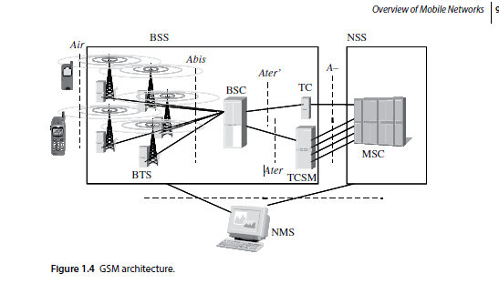
Second Gen Mobile Networks
2nd Gen
Base Station Subsystem (BSS)
Base Transceivers Station (BTS)
Base Station Controller (BSC)
Network Sub System (NSS)
Interface btwn the GSM nw & Public nw
Interface between network & mobile station
Hub of whole N/w
Abis
X.25.
A
Controls the Radio System Especially Base Stations
Transcoder Sub-Multiplexer (TCSM)
Sometimes Physically located in MSC
Mobile Switching Centre (MSC)
Home Location Register (HLR)
Visitor Location Register (VLR)
Simply a switch
Authentication Centre (AUC)
Eq. Identity Register (EIR)
Network Management System
Ensures the running of the network is smooth
4 main tasks
N/w monitoring
N/w development
N/w measurements
Fault management
2nd Gen Interfaces
Air
Abis Interference
Most important
TDMA/FDMA diff.
Between BTS & BSC
PCM Interface
A Interface
Between TCSM & MSC
2nd Gen Signalling
LAPDm
SS7
Modified link access protocol for D-Channel
Basis of all the signaling traffic
X.25
Links BSC to the O&M centre

Slide 7
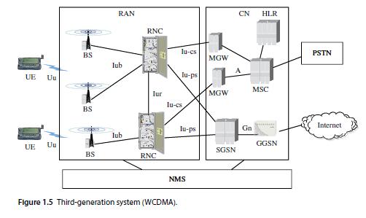
Third Gen Mobile Networks
RAN
Base Station (BS)
Radio Network Controller (RNC)
Core Network
Consists of two domains
3G
NodeB
Interface between BS & CN Responsible for Control of Radio resources
Circuit Switched
Packet Switched
WCDMA Mobile Switching Centre
Call control activities
MGW
SGSN-Interface between ran & PS Domain
HLR
Mobile user data
MSC
GGSN
Interface between 3G network & external PS Domain
NMS
Network Management System, Manages Packet Switched Data
WCDMA
Iub Interface
3G- Interfaces
Iur Interface
Iu
Air
Uplink Freq- 1920 -1980 MHz
Downlink Freq -2110-2170 MHz
Between BS- RNC
Unique to WCDMA, RNC-RNC
RAN-CN
RAN- CN(CS)->Iu- cs
RAN –CN(PS) -> Iu-ps
 | User Data | Control Data
User Plane | Application Layer | Application Layer | Control Plane
 | Presentation Layer | Presentation Layer
 | Session Layer | Session Layer
 | Transport Layer | Transport Layer
Transport Plane | Network Layer |  | Transport Plane
 | Data Layer
 | Physical Layer

Slide 8
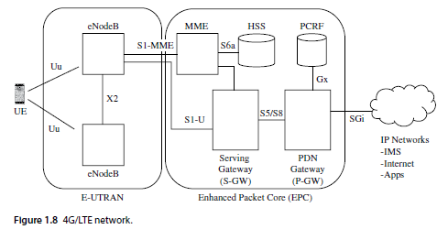
Fourth Gen Mobile Networks
4G
Enhanced Base Station eNodeB
Mobility Management Entity
Interfaces with the access network
Key functions such as band sharing, MME Pooling, Paging Etc.
S-GW
P-GW
HSS
Connects the data between eNb – P-GW
Connects UE to External Packet Data Networks
sGi Interface
Similar to the one used in GSM and UMTS networks
Central database that has information – both user and subscription related
4G- Interface
X2
S1
Interface between 2 eNodeB’s
E-UTRAN and MME
User plane
Component plane

Slide 9
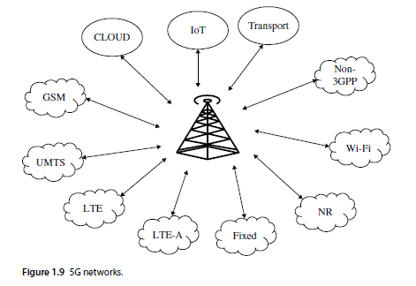
Fifth Gen Mobile Networks

Slide 10
Supporting Technologies
Supporting Technologies
ADSL 2+
VDSL2
FFTN
V+
GPON
GEPON
G.FAST
Bringing broadband to homes
Various types
Symetric / asymetric
Very- high- bit- rate DSL
Faster than ADSL
52 Mbps Downstream, 16 Mbps Upstream
Fiber to the Node
Fiber spreads to neighbourhood
Delivery speeds more than 200 Mbs up to 500m
Gigabit Passive Optical Network
Point to multipoint
Gigabit Ethernet PON
Uses ethernet
DSL standard for local loops <= 500m
XGS-PON
XG.PON1
GPON improved
Asymetric
Like XG.PON1 but symetric
NGPON2
Time and wavelength division multiplexing
NB-IoT
LTE eMTC
RFID
to provide connectivity to devices in indoor locations in 3GPP release 13. This is
eMTC stands for Enhanced Machine Type Communications.
small electronic devices that contain a chip and antenna

Slide 11
Supporting Technologies
Supporting Technologies
ZigBee
NFC
Exchange of data for 10cm
Low cost, Low power wireless M2M networks
Z-Wave
Home devices internal communication
LoRa
Long Rage Wide Area Networks
SigFox
Low Power Wide Area Network
Li-Fi
Visible Light Communication. Still on production
V2V and V2I
Part of vehicular transportation systems (VTS)
SRD
Short Range Devices
Less interfence to the other radio services
RLAN
PMR
WIFI! Wireless LAN
Professional mobile radio / Private mobile radio

Slide 12
Radio Network Planning and Optimisation

